Slide 1
Web Systems and Algorithms
Unit 3 (Creating Suggestions and Recommendations)

Slide 2
Item Based Collaborative Filtering
Looks into the set of items the target user has rated and computes how similar they are to the target item and then selects k most similar items
Prediction is computed by taking a weighted average on the target user’s ratings on the most similar items
Similarity between item i and j
Cosine based Similarity
Correlation based Similarity (Pearson Correlation)

Slide 3
Item Based Collaborative Filtering (Example)…
Consider the following dataset of movies
User | Movie | Rating
U1 | M1 | 4
U1 | M2 | 5
U2 | M1 | 5
U3 | M1 | 3
U2 | M3 | 2
U3 | M3 | 3
U3 | M2 | 1
U4 | M3 | 2
U5 | M1 | 1
U4 | M2 | 2
U5 | M3 | 3

Slide 4
Item Based Collaborative Filtering (Example)…
Here, the dimension of vector will be
the number of users that both have
rate the both item
Step 1 : Create the user item rating matrix
Step 2 : Find the similarity between items
Sim(M1, M2) = (5*2 + 3*3 + 1*3)/(sqrt(35)*sqrt(22)) = 0.81
Sim(M1, M3) = 0.90
Sim(M2, M3) = 0.86
Step 3: Calculate the possible rating value
Suppose, here we have to find the rate value for movie M2 by U1
Rate_{U1,M2} = (4*0.81 + 5*0.90) / (0.81 + 0.90) = 7.74/1.71 = 4.5
 | U1 | U2 | U3 | U4 | U5
M1 | 4 | 5 | 3 | ? | 1
M2 | ? | 2 | 3 | 2 | 3
M3 | 5 | ? | 1 | 2 | ?
 | M1 | M2 | M3
M1 | 1
M2 | 0.81 | 1
M3 | 0.90 | 0.86 | 1
4.5

Slide 5
Item Based Collaborative Filtering (Exercise |N|=2)…
 | U1 | U2 | U3 | U4 | U5 | U6 | U7 | U8 | U9 | U10 | U11 | U12
M1 | 1 | ? | 3 | ? | ? | 5 | ? | ? | 5 | ? | 4 | ?
M2 | ? | ? | 5 | 4 | ? | ? | 4 | ? | ? | 2 | 1 | 3
M3 | 2 | 4 | ? | 1 | 2 | ? | 3 | ? | 4 | 3 | 5 | ?
M4 | ? | 2 | 4 | ? | 5 | ? | ? | 4 | ? | ? | 2 | ?
M5 | ? | ? | 4 | 3 | 4 | 2 | ? | ? | ? | ? | 2 | 5
M6 | 1 | ? | 3 | ? | 3 | ? | ? | 2 | ? | ? | 4 | ?
2.5
Suppose we have to estimate the rating of M1 by U5
Calculate the similarity matrix
Now, Rating_{U5,M1} = (2*0.97 + 3*1) / (0.97+1)
= 4.94 / 1.97
= 2.5
Sim(M1,M2) =
Sim(M1,M3) =
Sim(M1,M4) =
Sim(M1,M5) =
Sim(M1,M6) =
0.75
0.97
0.89
0.87
1.00

Slide 6
Frequent Pattern
Frequent pattern: a pattern (a set of items, subsequences, substructures, etc.) that occurs frequently in a data set
frequent itemsets and association rule mining
Motivation: Finding inherent regularities in data
What products were often purchased together?— Beer and diapers?!
What are the subsequent purchases after buying a PC?
What kinds of DNA are sensitive to this new drug?
Can we automatically classify web documents?
Applications
Basket data analysis, cross-marketing, catalog design, sale campaign analysis, Web log (click stream) analysis, and DNA sequence analysis.

Slide 7
Basic Concepts: Frequent Patterns and Association Rules
Transaction-id | Items bought
10 | A, B, D
20 | A, C, D
30 | A, D, E
40 | B, E, F
50 | B, C, D, E, F
Itemset X = {x₁, …, x_{k}}
Find all the rules X → Y with minimum support and confidence
support, s, probability that a transaction contains X ∪ Y
confidence, c, conditional probability that a transaction having X also contains Y
Customer
buys both
Customer
buys diaper
Let sup_{min} = 50%, conf_{min} = 50%
Freq. Pat.: {A:3, B:3, D:4, E:3, AD:3}
Association rules:
A → D (60%, 100%)
D → A (60%, 75%)
Customer
buys beer

Slide 8
Association Rules
Example1: a female shopper buys a handbag is likely to buy shoes
Example2: when a male customer buys beer, he is likely to buy salted peanuts
We will represent an association rule in the following way:
MUSIC_MAG, HOUSE_MAG=>CAR_MAG
Somebody that reads both a music and a house magazine is also very likely to read a car magazine

Slide 9
Association Mining
Association rule mining:
Finding frequent patterns, associations, correlations, or causal structures among sets of items or objects in transaction databases, relational databases, and other information repositories.
Applications:
Basket data analysis, cross-marketing, catalog design, loss-leader analysis, clustering, classification, etc.
Examples.
Rule form: “Body → Ηead [support, confidence]”.
buys(x, “diapers”) → buys(x, “beers”) [0.5%, 60%]
major(x, “CS”) ^ takes(x, “DB”) → grade(x, “A”) [1%, 75%]

Slide 10
Association Rule Mining: A Road Map
Boolean vs. quantitative associations (Based on the types of values handled)
buys(x, “SQLServer”) ^ buys(x, “DMBook”) → buys(x, “DBMiner”) [0.2%, 60%]
age(x, “30..39”) ^ income(x, “42..48K”) → buys(x, “PC”) [1%, 75%]
Single dimension vs. multiple dimensional associations (each distinct predicate of a rule is a dimension)
Single level vs. multiple-level analysis (consider multiple levels of abstraction)
What brands of beers are associated with what brands of diapers?

Slide 11
Apriori: A Candidate Generation-and-Test Approach
Apriori pruning principle: If there is any itemset which is infrequent, its superset should not be generated/tested!
Method:
Initially, scan DB once to get frequent 1-itemset
Generate length (k+1) candidate itemsets from length k frequent itemsets
Test the candidates against DB
Terminate when no frequent or candidate set can be generated

Slide 12
The Apriori Algorithm
Pseudo-code:
C_{k}: Candidate itemset of size k
L_{k} : frequent itemset of size k
L₁ = {frequent items};
for (k = 1; L_{k} !=∅; k++) do begin
C_{k+1} = candidates generated from L_{k};
for each transaction t in database do
increment the count of all candidates in C_{k+1} that are contained in t
L_{k+1} = candidates in C_{k+1} with min_support
end
return ∪_{k} L_{k};

Slide 13
The Apriori Algorithm
Begin
Initialise the candidate Item-sets as single items in database.
Scan the database and count the frequency of the candidate item-sets, then Large Item-sets are decided based on the user specified min_sup.
Any new Large
Item-sets?
NO
YES
Based on the Large Item-sets, expand them with one more item to generate new Candidate item-sets.
Stop

Slide 14
Apriori: A Candidate Generation-and-test Approach
Any subset of a frequent itemset must be frequent
if {beer, diaper, nuts} is frequent, so is {beer, diaper}
Every transaction having {beer, diaper, nuts} also contains {beer, diaper}
Apriori pruning principle: If there is any itemset which is infrequent, its superset should not be generated/tested!

Slide 15
The Apriori Algorithm—An Example
Sup_{min} = 2
Itemset | sup
{A} | 2
{B} | 3
{C} | 3
{D} | 1
{E} | 3
Database TDB
Itemset | sup
{A} | 2
{B} | 3
{C} | 3
{E} | 3
L₁
Tid | Items
10 | A, C, D
20 | B, C, E
30 | A, B, C, E
40 | B, E
C₁
1st scan
C₂
Itemset | sup
{A, B} | 1
{A, C} | 2
{A, E} | 1
{B, C} | 2
{B, E} | 3
{C, E} | 2
C₂
Itemset
{A, B}
{A, C}
{A, E}
{B, C}
{B, E}
{C, E}
L₂
Itemset | sup
{A, C} | 2
{B, C} | 2
{B, E} | 3
{C, E} | 2
2nd scan
C₃
Itemset
{B, C, E}
3rd scan
L₃
Itemset | sup
{B, C, E} | 2

Slide 16


The Apriori Algorithm—An Example …
Rules (Minimum Confidence = 75%)
Conf(A→B) = (A ∪ B) / A
Now
B → C × E :Confidence = 2/3 = 66%
C → B × E :Confidence = 2/3 = 66%
E → B × C :Confidence = 2/3 = 66%
C × E → B :Confidence = 2/2 = 100%
B × E → C :Confidence = 2/3 = 66%
B × C → E :Confidence = 2/2 = 100%

Slide 17
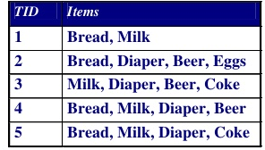
The Apriori Algorithm—An Exercise

Slide 18
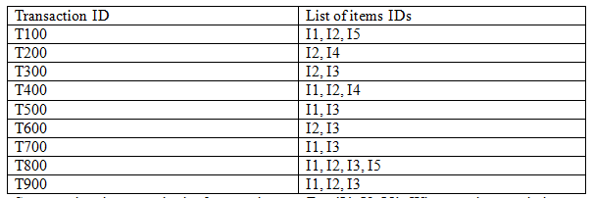
The Apriori Algorithm—An Exercise
Minimum Support = 2
Minimum Confidence = 75%

Slide 19
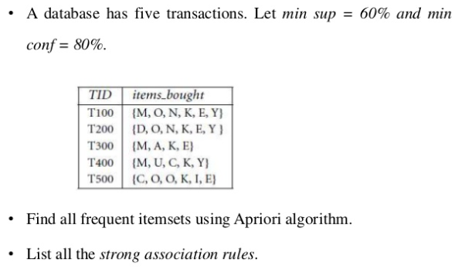
The Apriori Algorithm—An Exercise

Slide 20
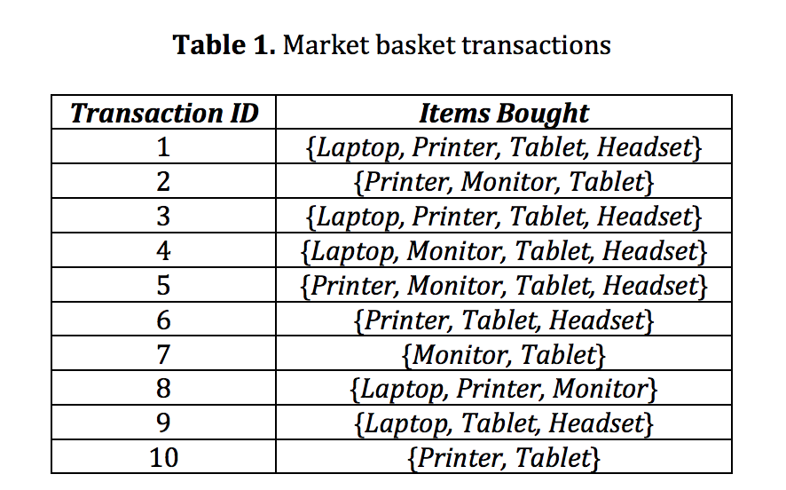
The Apriori Algorithm—An Exercise

Slide 21
Mining Multilevel Association
Items often form hierarchies
Association rules generated from mining data at multiple levels of abstraction are called multiple-level or multilevel association rules
Using uniform minimum support for all levels
Using reduced minimum support at lower levels
uniform support
reduced support
Level 1
min_sup = 5%
Milk
[support = 10%]
Level 1
min_sup = 5%
Level 2
min_sup = 5%
DDC Milk
[support = 6%]
ND Milk
[support = 4%]
Level 2
min_sup = 3%

Slide 22
Mining Multi-Dimensional Association
Single-dimensional rules:
buys(X, “milk”) ⇒ buys(X, “bread”)
Multi-dimensional rules: ≥ 2 dimensions or predicates
Inter-dimension assoc. rules (no repeated predicates)
age(X,”19-25”) ∧ occupation(X,“student”) ⇒ buys(X, “coke”)
hybrid-dimension assoc. rules (repeated predicates)
age(X,”19-25”) ∧ buys(X, “popcorn”) ⇒ buys(X, “coke”)

Slide 23
Problems with A-priori Algorithms
It is costly to handle a huge number of candidate sets. For example if there are 10⁴ large 1-itemsets, the Apriori algorithm will need to generate more than 10⁷ candidate 2-itemsets. Moreover for 100-itemsets, it must generate more than 2¹⁰⁰ ≈ 10³⁰ candidates in total.
When Database is scanned to check C_{k} for creating L_{k}, a large number of transactions will be scanned even they do not contain any k-itemset.

Slide 24
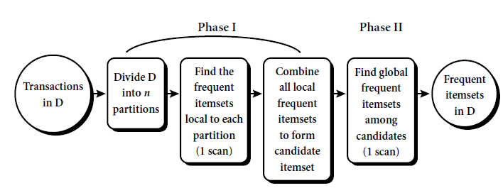
Some techniques to improve perfomance of Apriori
Transaction reduction
Any transaction without k-itemset is not necessary to be involved in next scan
Sampling
Reduce the load
Partitioning

Slide 25
Mining Frequent Itemsets without Candidate Generation
FP-Growth (Frequent Pattern Growth)
FP growth algorithm used for finding frequent itemset in a transaction database without candidate generation
Method for mining the complete set of frequent patterns by pattern fragment growth, using an extended prefix-tree structure for storing compressed and crucial information about frequent patterns named frequent-pattern tree (FP-tree)

Slide 26
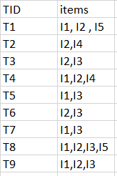

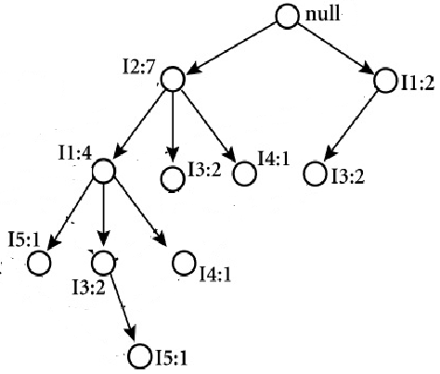
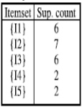
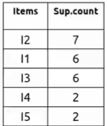
FP Growth (Example)
FP Tree Construction
2
3
null
I2:1
I4:1
I3:1
I1:1
Sort
I2,I1,I5
I5:1
I2, I4
I2, I3
L1
Sort in
descending
order

Slide 27
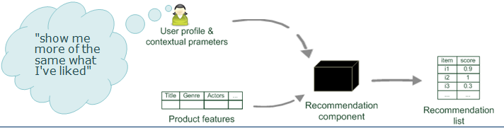
Content Based Recommendation
Recommend items to customer X, similar to previous items highly rated by X
Item Representations (TF-IDF)
Cosine Similarity
Nearest Neighbors (N = 5 i.e. recommend top 5 items)

Slide 28
Content Based Recommendation(Probabilistic Approach)…
P(X | Y ) = (P(Y | X) * P(X)) / P(Y)
Rate_{Alice,Item5} = ?
P(Rate_{Alice,Item5} | Rate_{Alice,Item1=1}, Rate_{Alice,Item2=3}, Rate_{Alice,Item3=3}, Rate_{Alice,Item4=2}) = ?
 | Item1 | Item2 | Item3 | Item4 | Item5
Alice | 1 | 3 | 3 | 2 | ?
User1 | 2 | 4 | 2 | 2 | 4
User2 | 1 | 3 | 3 | 5 | 1
User3 | 4 | 5 | 2 | 3 | 3
User4 | 1 | 1 | 5 | 2 | 1
P(Rate_{Alice,Item5=1} | Rate_{Alice,Item1=1}, Rate_{Alice,Item2=3}, Rate_{Alice,Item3=3}, Rate_{Alice,Item4=2}) = ?
P(Rate_{Alice,Item5=2} | Rate_{Alice,Item1=1}, Rate_{Alice,Item2=3}, Rate_{Alice,Item3=3}, Rate_{Alice,Item4=2}) = ?
P(Rate_{Alice,Item5=3} | Rate_{Alice,Item1=1}, Rate_{Alice,Item2=3}, Rate_{Alice,Item3=3}, Rate_{Alice,Item4=2}) = ?
P(Rate_{Alice,Item5=4} | Rate_{Alice,Item1=1}, Rate_{Alice,Item2=3}, Rate_{Alice,Item3=3}, Rate_{Alice,Item4=2}) = ?
P(Rate_{Alice,Item5=5}| Rate_{Alice,Item1=1}, Rate_{Alice,Item2=3}, Rate_{Alice,Item3=3}, Rate_{Alice,Item4=2}) = ?

Slide 29
Content Based Recommendation(Probabilistic Approach)…
= P(Rate_{Alice,Item1=1}, Rate_{Alice,Item2=3}, Rate_{Alice,Item3=3}, Rate_{Alice,Item4=2} | Rate_{Alice,Item5=1} ) *P(Rate_{Alice,Item5=1} )
 | Item1 | Item2 | Item3 | Item4 | Item5
Alice | 1 | 3 | 3 | 2 | ?
User1 | 2 | 4 | 2 | 2 | 4
User2 | 1 | 3 | 3 | 5 | 1
User3 | 4 | 5 | 2 | 3 | 3
User4 | 1 | 1 | 5 | 2 | 1
= 2/2 * 1/2 * 1/2 * 1/2 * 1/4
= 0.03

Slide 30

Evaluating Recommender System
RMSE (Root Mean Square Error)
Where, T is the set of test data and N = |T|
r_{x,i} is the predicted rating and r*_{x,i} is the actual rating

Slide 31
End of Unit 3

